Slide 1

Module 5
Processor Logic Design: Register transfer
logic – interregister transfer – arithmetic,
logic and shift micro operations –
conditional control statements.
Processor organization: Design of
arithmetic unit, logic unit, arithmetic logic
unit and shifter – status register –
processor unit – design of accumulator.

Slide 2
Register-Transfer Logic
• A digital system is a sequential logic system
• A sequential circuit can be specified by means of a state table.
• To specify a large digital system with a state table would be very difficult
• To overcome this difficulty, digital systems are designed using a modular
approach
– The system is partitioned in to modular subsystems each of which performs
some functional task
– Eg: registers, counters, decoders, multiplexers, arithmetic elements, control
logic
– Modules are interconnected with common data and control paths to form a
digital computer system
• Higher level mathematical notation is required to describe a digital system in
terms of the modular subsystem
– Register-transfer logic (RTL) method
– Registers are the primitive components in a digital system
– Uses a set of expressions and notations

Slide 3
Basic Components of Register-Transfer Logic
Method
1. The set of registers in the system and their functions
– Shift Register, Counter, Memory Units
2. The binary-coded information stored in the registers
– BCD Numbers, Binary Numbers, Alpha Numeric Characters, Control Informations
3. The operations performed on the information stored in the registers
– Micro-operations – shift, add, clear, load, etc.
4. The control functions that initiate the sequence of operations
– consists of timing signals that sequence the operations one at a time

Slide 4
Register-Transfer Logic
• Register-transfer logic uses a set of expressions and notations
• Provides the necessary tools
• RTL is a symbolic notation for representing registers, for
specifying operations on the contents of registers, and for
specifying control functions
• Also known as register-transfer language or computer
hardware-description language

Slide 5
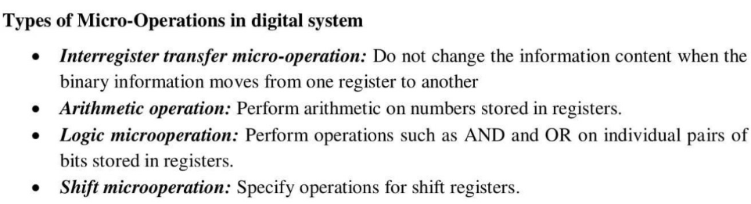
Micro-operations – 4 Types

Slide 6
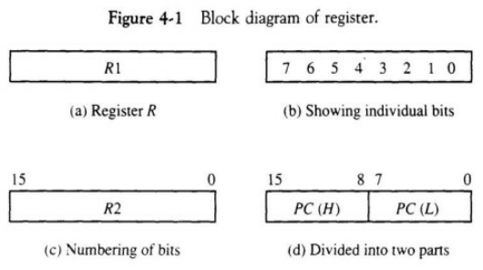
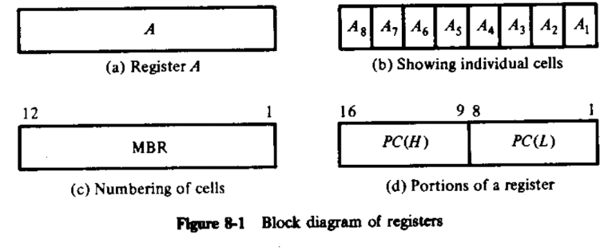
1. Inter-register Transfer - Register
Representation

Slide 7
Interregister Transfer
●
Interregister transfer is designated in symbolic form by
means of Replacement Operator ←
A ← B
- denotes the transfer of the contents of register B to
register A
Conditional transfer: Register transfer occurs only under
a control condition. A control function is a Boolean
function hat can be equal to 0 or 1.

Slide 8
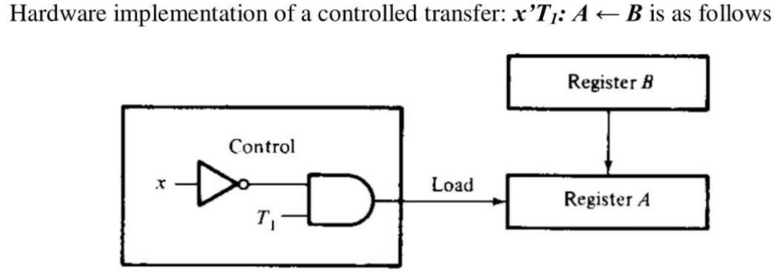
Interregister Transfer - Conditional
transfer
●
Represented as x'T1: A ← B
●
x'T1 is the control function which is terminated with a colon

Slide 9
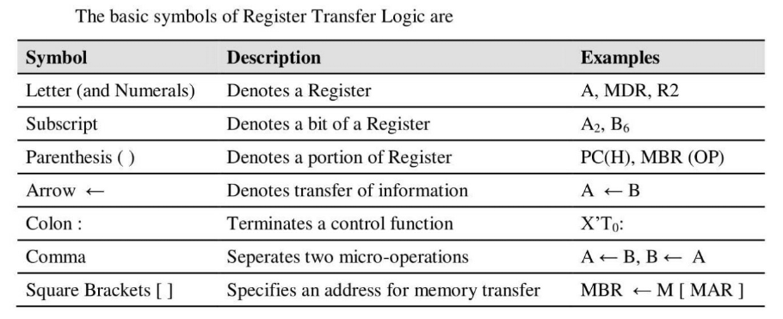
Interregister Transfer – Basic symbols

Slide 10
Interregister Transfer - Conditional transfer
●
Eg: Consider a destination register
receives information from two sources at
two different times
T1: C ← A
T5: C ← B

Slide 11
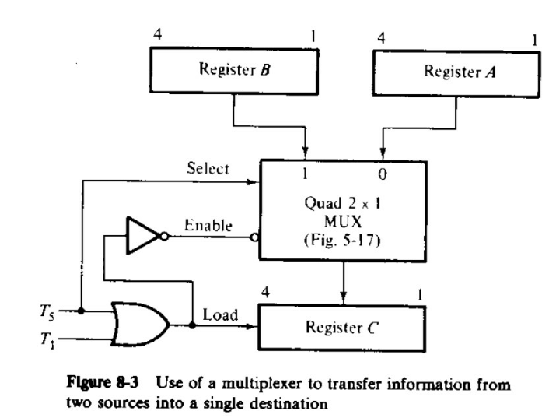

Slide 12
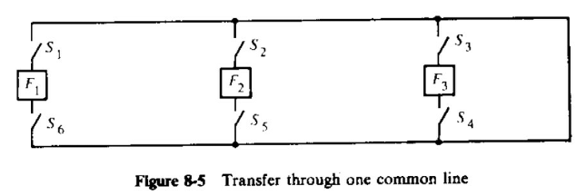
Bus transfer

Slide 13
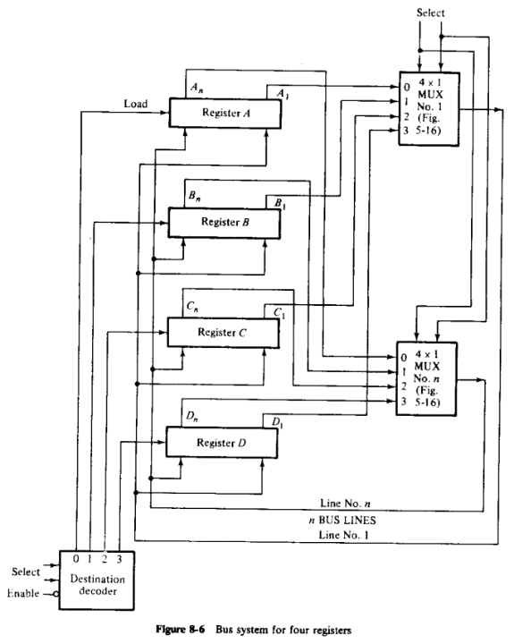

Slide 14
Bus transfer
●
For eg: for the interregister transfer,
C ← A
−
The multiplexer and decoder select inputs must be:
●
Select source – 10 (MUXs select register A)
●
Select destination – 10 (decoder selects register C)
●
Decoder enable – 0 (decoder is enabled)
●
On the next clock pulse, the contents of A being on the bus, are
loaded into register C

Slide 15
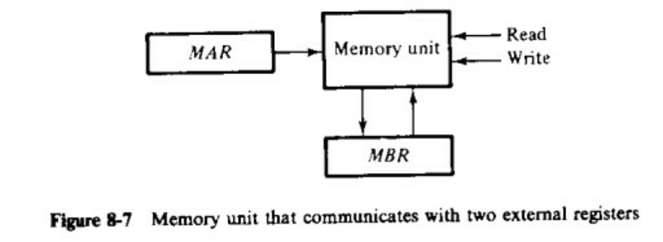
Memory Transfer

Slide 16
Memory transfer operations
●
Read operation
−
R: MBR ← M
−
R is the control function that initiates the read operation
●
Write operation
−
W: M ← MBR
−
W is the control function that initiates the write operation

Slide 17
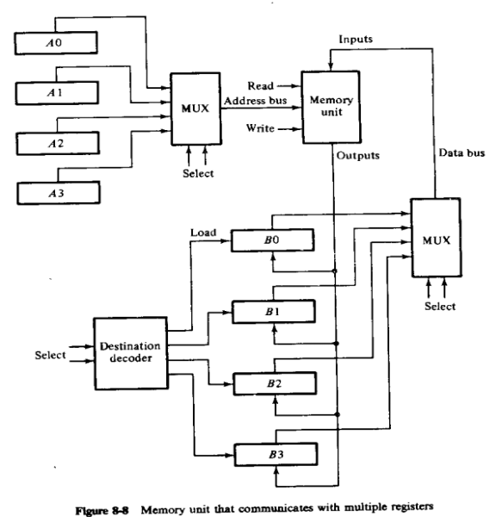
Memory Transfer – Multiple Registers
1. Read operation
R: B0 ← M[A3]
2. Write operation
W: M[A1] ← B2

Slide 18
Memory Transfer – Multiple Registers ...
●
Read operation
−
R: B0 ← M[A3]
●
R is the control function that initiates the read operation
●
Write operation
−
W: M[A1] ← B2
●
W is the control function that initiates the write
operation

Slide 19
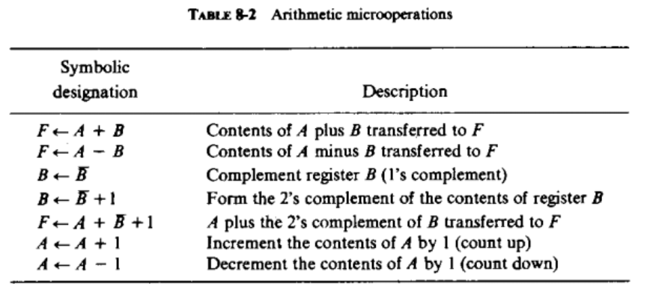
2. Arithmetic micro-operations

Slide 20
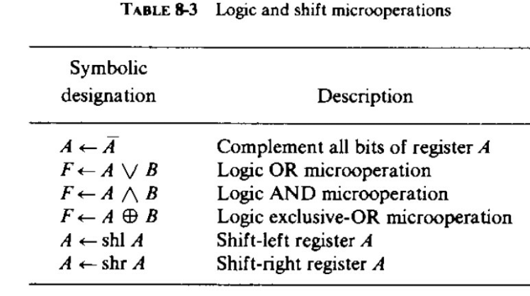
3. Logic micro-operations
●
Specify binary operations for a string of bits stored in registers
●
Each bit in the registers are treated separately

Slide 21
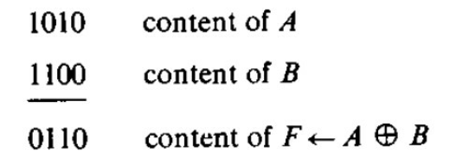
Logic micro-operations ...

Slide 22
4. Shift micro-operations
●
Transfer binary information between registers
●
Also used for arithmetic, logic and control operations
●
Left shift, right shift or circular shift
●
Micro-operations that specify a 1-bit left-shift and 1-bit
right-shift:
●
A ← shl A, B ← shr B

Slide 23
Conditional Control Statements
•Control condition is specified by a conditional
statement rather than a Boolean control function
•if-then-else statement
•
P: if (condition) then [micro-operation(s)] else
[micro-operation(s)]
•In other words,
T : if (C=0) then (F ← 1) else (F ← 0)
2
•If C is a one bit register the statement is equivalent to
the following two statements.
C’T : F ← 1
CT : F ← 0
2
2

